Slide 1
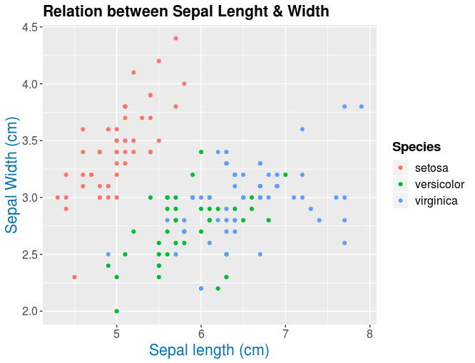
ggtitle("Relation ...")
plot.title = element_text(...)
axis.text.y = element_text(size...)
legend.title = element_text(size...)
ylab("Sepal ...)")
axis.title.y = element_text(size...)
legend.text = element_text(...)
axis.text.x = element_text(size...)
xlab("Sepal ...")
axis.title.x = element_text(size...)

